Slide 1




Smart pricing in NYC
Alvin Du, Gao Jie, Scott Yim, Alex Barry
December 17, 2019
Data Mining for Business Analytics
Professor Claudia Perlich

Slide 2

Agenda
Problem Definition + Example Scenario
Business Case
Our Data Mining Process
Evaluation
Analysis + Insights
Applications + Learnings

Slide 3
Problem Definition
There are many options that NYC visitors can book on Airbnb.
For a new or returning Airbnb host, it can be difficult to know how to price a property competitively given the amenities it offers, but also the number of other Airbnbs out there on the market.

Slide 4

Example Scenario
Jane is a new Airbnb host.
She owns her apartment and wants to list it on Airbnb.

Slide 5
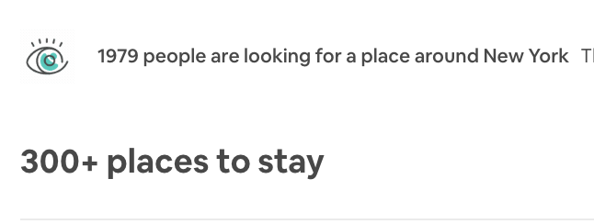
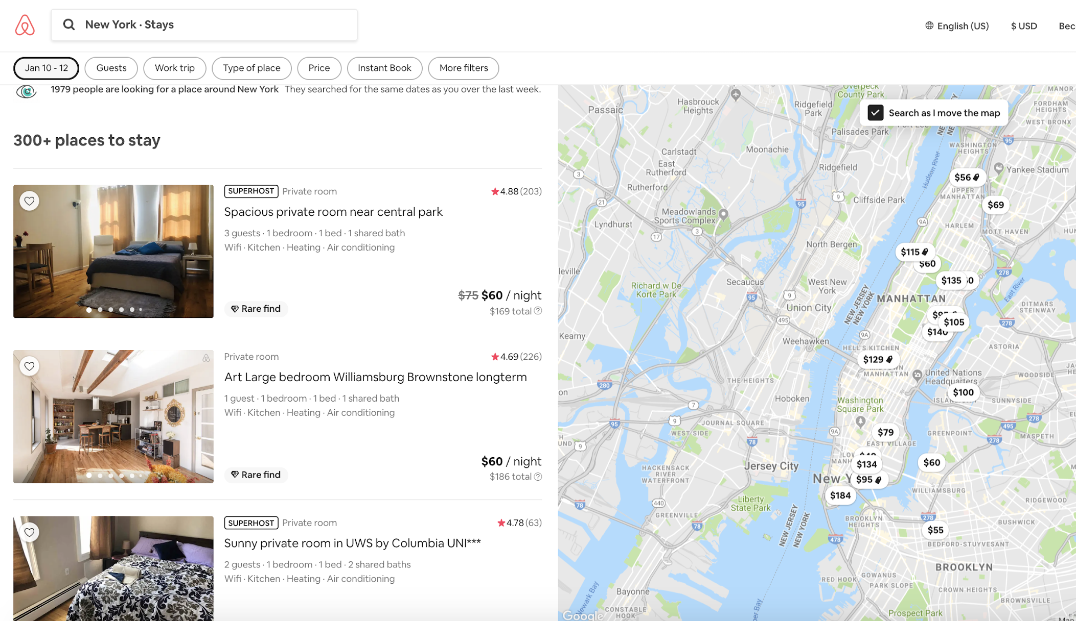
Example Scenario
There’s no shortage of demand, but she wants to price competitively and to know if she can make any alterations to help make her apartment more valuable (air conditioning, TV, etc.).

Slide 6
Business Case
Objective: To help hosts strategically price their Airbnb rental properties based on:
Rental type
Features
Amenities
Proposal: Use pricing model based on historical Airbnb data to identify which features of a property affect price

Slide 7
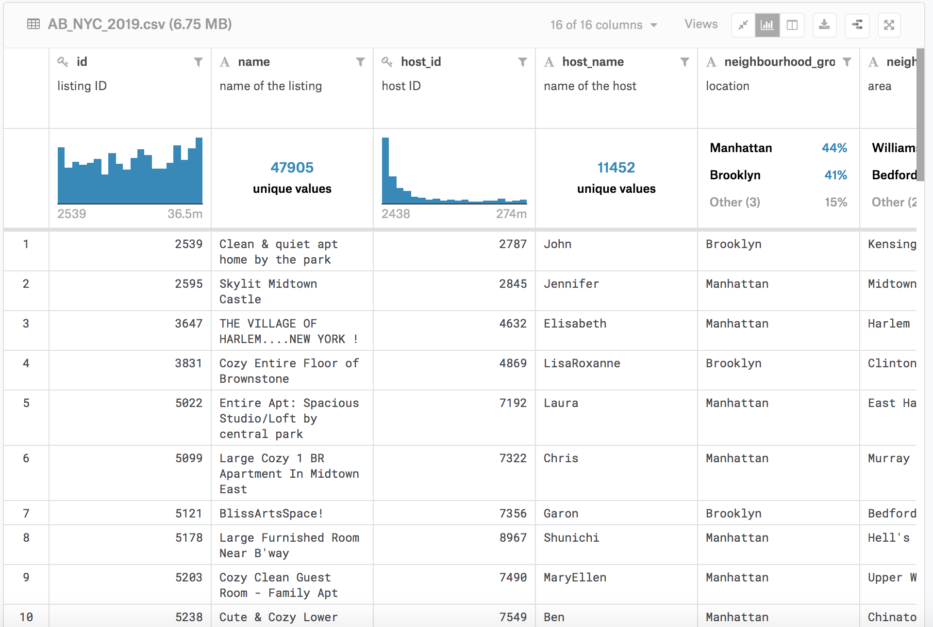
Data Mining Process: Initial Dataset
Dataset 1: 2019 NYC Airbnbs (Kaggle.com)
48.9K 16
ROWS COLUMNS
Features including:
neighborhood (categorical)
neighborhood_group (categorical)
very high dimensionality - 220
price (numeric)
property_type (binary)
number of reviews (numeric)
availability 365 (numeric)

Slide 8
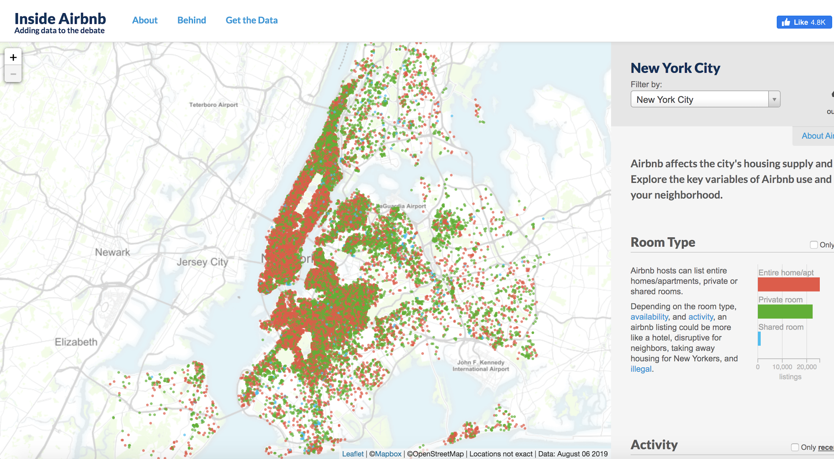
Data Mining Process: Additional Data
Dataset 2: 2019 NYC Airbnb Features (InsideAirbnb.com)
48.3K 106
ROWS COLUMNS
Features including:
beds (numeric)
bathrooms (numeric)
bedrooms (numeric)
bed_type (categorical)
amenities (converted to binary)
guests_included (binary)
cleaning_fee (numeric)
extra_people (numeric)
review_scores_rating (numeric)

Slide 9
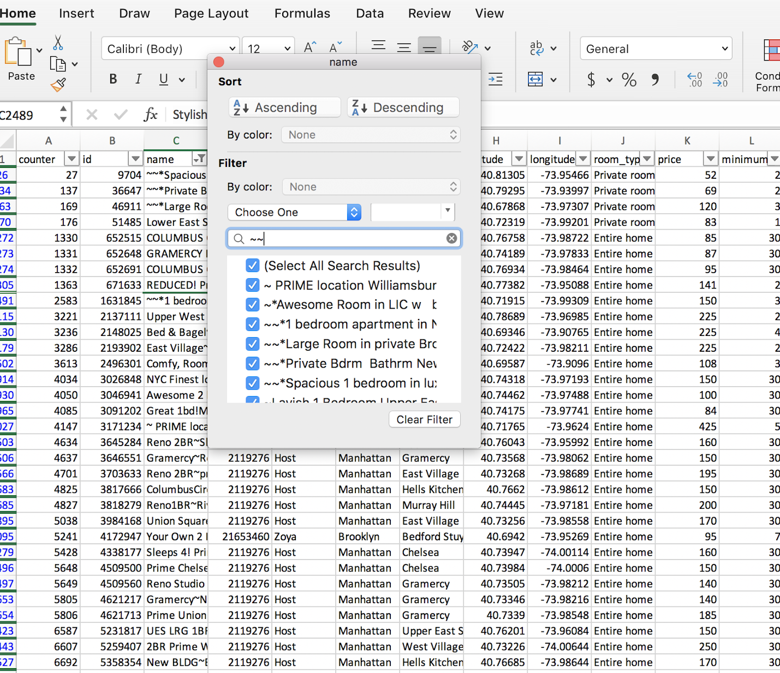
Data Mining Process: Excel work
Vlookup on unique ‘id’ identifier to merge dataset 1 and dataset 2
Filter to identify issues / stray characters / anomalies in data
~, *, ::::, etc.
Scraping problems (blanks, negative values, etc.)
Find and replace to adjust values
Filter to sort and delete erroneous rows (very manual)

Slide 10
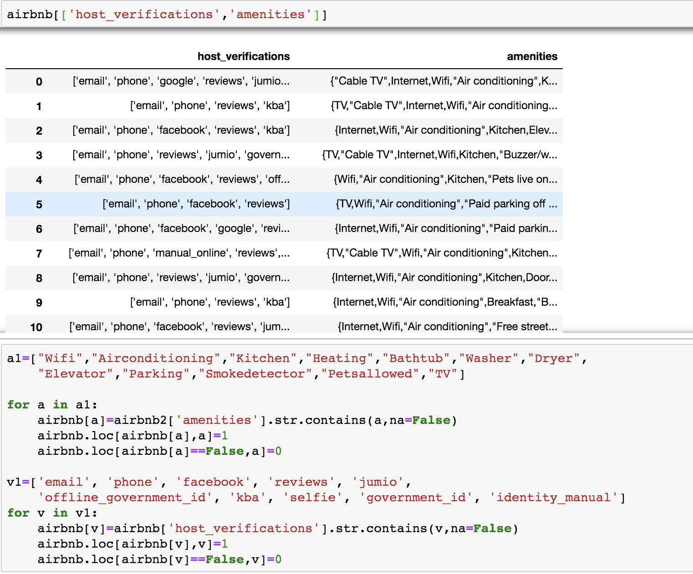
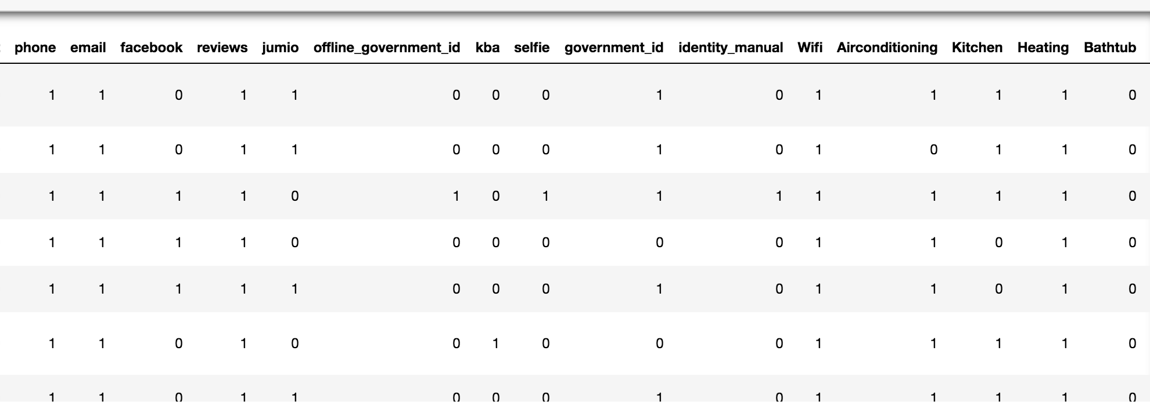
Data Mining Process: Python work
Filter the variables of interest
Create binary variables for categorical features
Host_verifications and amenities
1 if has, 0 if not
Calculate total number
total amenities & total host verifications
Insert screenshot here

Slide 11
Data Mining Process: Final Dataset
Merged and parsed both datasets using Python and Excel
42K 43
ROWS COLUMNS
Features including:
host_has_profile_pic
beds
bathrooms
bedrooms
bed_type
guests_included
cleaning_fee
extra_people
review_scores_rating
A/C
wifi
email
phone

Slide 12
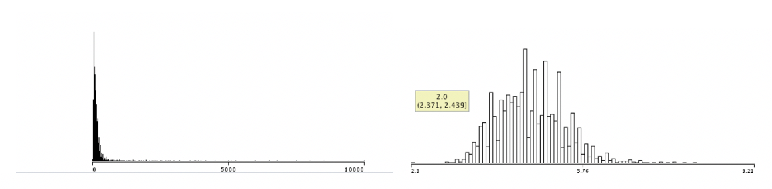
Modeling
Target Variable: Natural Log Price
Regression:
REPTree
Linear Regression Model(LR)
M5P: a combination of decision tree and linear regression
Notes:
Plot the distribution of price and saw that it’s heavily left skewed
The solution is to natural log the prices to get a more normal distribution
Target variable is price so it is numeric
Models that evaluate numeric target variables are those listed above

Slide 13
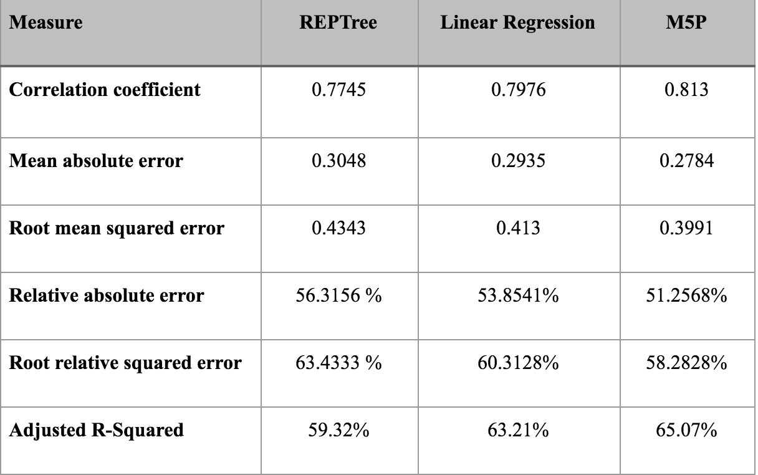
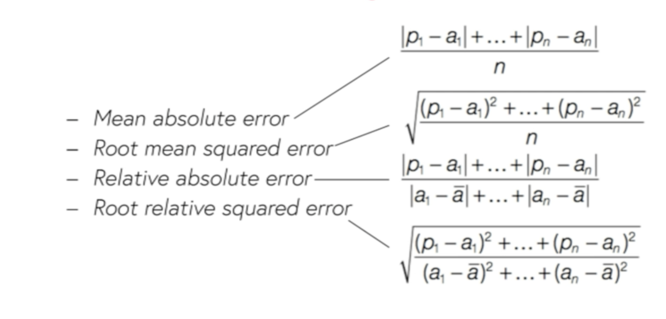
Prediction Model
Evaluation
Cross-validation folds 10
No lift curve and AUC
Squared error & adjusted R squared
All three models perform well in prediction
M5P is the best

Slide 14
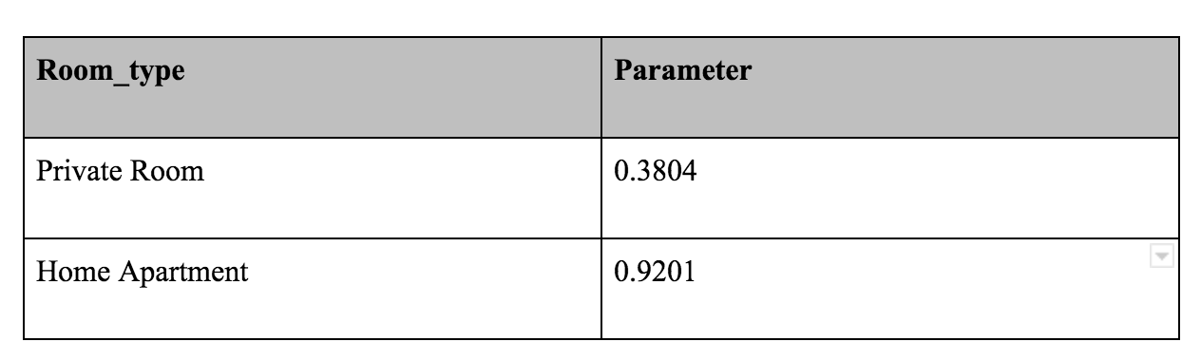
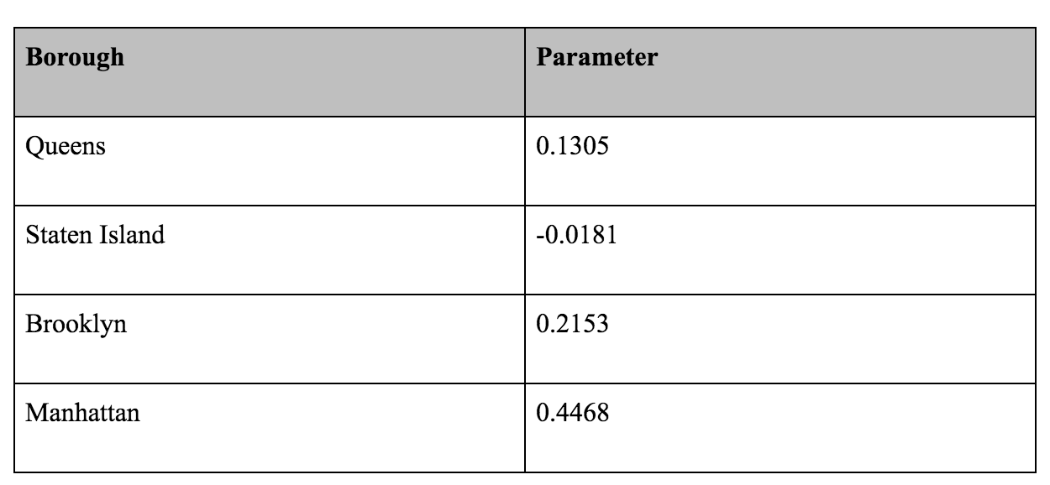
Factor Analysis
Use REPtree and LR
Perform fairly well
Parameters for each factors
Cross-validation 10 folds
Best Predictors (REPTree):
room_type
neighbourhood
review_scores_rating
Parameters (LR):
Room_type vs shared room
Neighbourhood vs Bronx
0 stars rating (1-10)
Notes:
10 folds, 9 observations 1 training set
Generalized evaluation to avoid overfitting
Too specific to our dataset so that if we run it with new data it would give completely different and inaccurate results
Use REPTree and LR because we can get estimates for the parameters that we can analyze. Whereas in the M5P it’s much harder to interpret the results. This allows host to make strategic pricing decisions based on amenities, room type, and location.
In the REPTRee the nodes at the top of the decision tree have the most explanatory power, and in this visualization we found that room type, neighborhood and review scores rating were at the top.
Benchmark comparisons for room type as shared room and Bronx as the borough.
Even though review scores has a very strong explanatory power for the effects on price, it doesn’t have a very clear analysis. First, the parameter estimate itself is low and negatively correlated with price. Second, there are a lot of zero scores which capture both new listings and very terrible listings. And there is no way to differentiate. So a zero score listing could be better priced and better quality than an older 1 star reviewed listing.

Slide 15
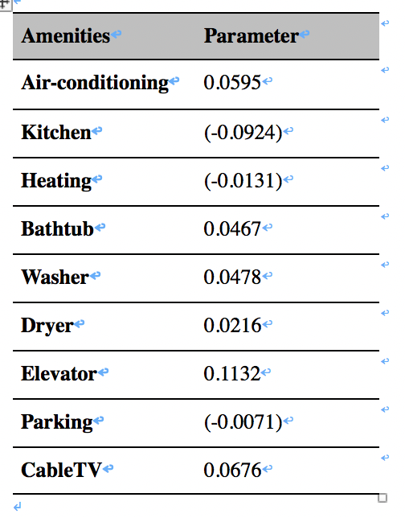
Other Interesting Findings
Based on our analysis of amenities, we found that...
Air conditioning in New York City is associated with a 6% increase in price
Including a kitchen in the listing is associated with a 9% decrease in price
Including an elevator is associated with a 11% increase in price
Including cable tv is associated with a 7% increase in price
A “real bed” is associated with a 4% increase in price
Notes:
The benchmark for bed type is a futon, so real bed is a 4% increase in price compared to a futon. A real bed is something that is not a futon, couch, airbed, or sofa.

Slide 16
Applications + Deployment
Airbnb host: dependent upon owner or renter
E.g. Add A/C, wifi, cleaning fee, extra guests allowed, etc.
Implications on profit made by Airbnb so ethical considerations on ensuring the output prices are factual and transparent, otherwise potential to drive prices up for the end consumer

Slide 17
Thank You + Questions

